Slide 1

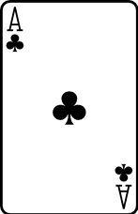


RING
OF
FIRE

Slide 2

Start game

